Slide 1

Department of Computer Science and Engineering
CLOUD COMPUTING
Installation of a C Compiler in a Virtual Machine
Presentation by
Mithra B
24CS0524
Supervisor
EMBEDDED PROGRAMMING PROJECT-ZEROTH REVIEW

Slide 2
CONTENTS
Experiment Aim
Virtual Machine & Tools
Install the C Compiler
Write and Save a C Program
Compile the Program
Execute and Verify Output
Result & Key Takeaways

Slide 3
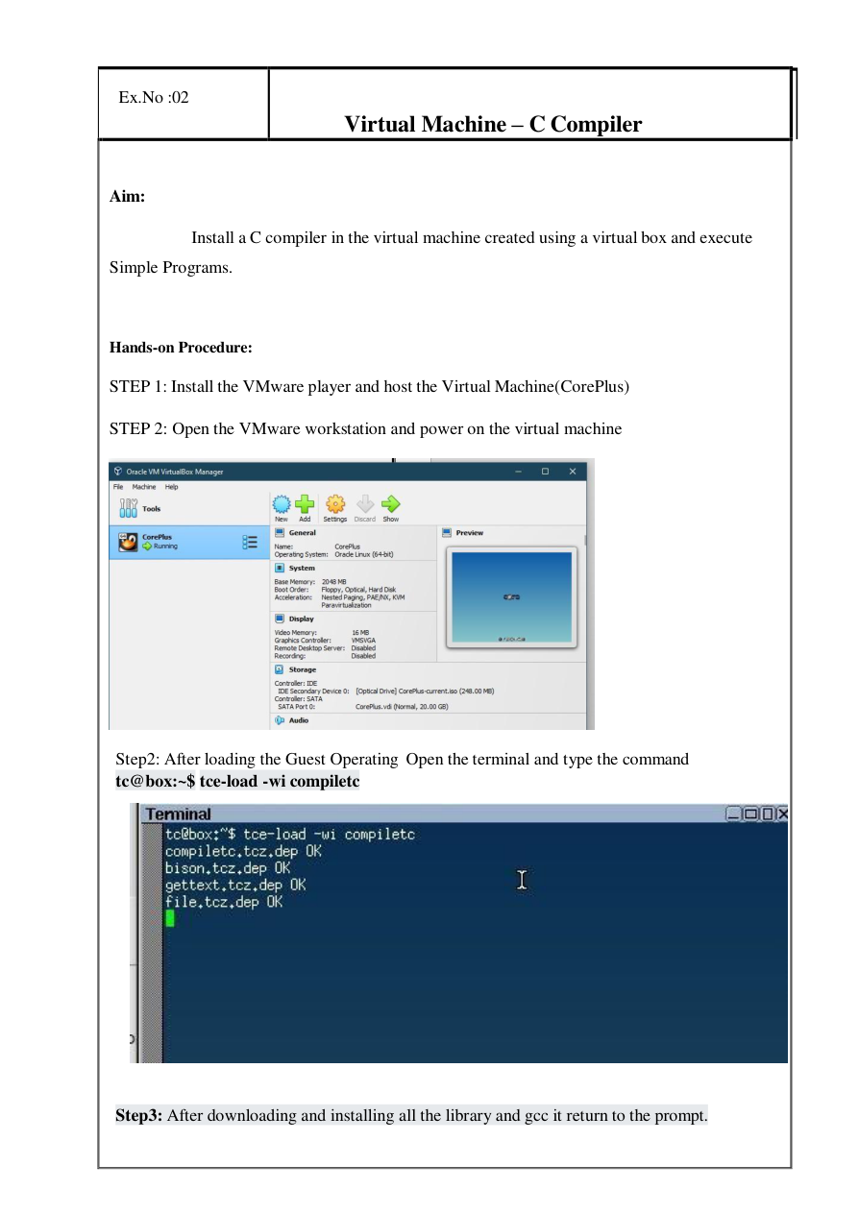
EXPERIMENT AIM
Ex. No: 02 — Virtual Machine – C Compiler
AIM
Install a C compiler in the virtual machine created using a virtual box and execute simple programms.
WHAT WE WILL ACHIEVE
• Start the guest virtual machine.
• Install the compiler toolchain and GCC libraries.
• Create a C source file inside the guest system.
• Compile the source file using cc.
• Execute the generated program and verify the output.

Slide 4
VIRTUAL MACHINE & TOOLS
LAB ENVIRONMENT
1. VMware Player / Workstation — hosts the virtual machine.
2. CorePlus guest OS — the Linux-based environment used in the manual.
3. Terminal — used to install the compiler and run commands.
4. compiletc package — installs the compiler toolchain and GCC libraries.
5. Text editor — used to create and save the .c source file.
6. cc compiler — converts the C source into an executable program.
FLOW
Host Windows → VMware → CorePlus VM → Terminal → C Compiler → Executable
HOST
VMWARE
COREPLUS
TERMINAL
GCC / CC

Slide 5
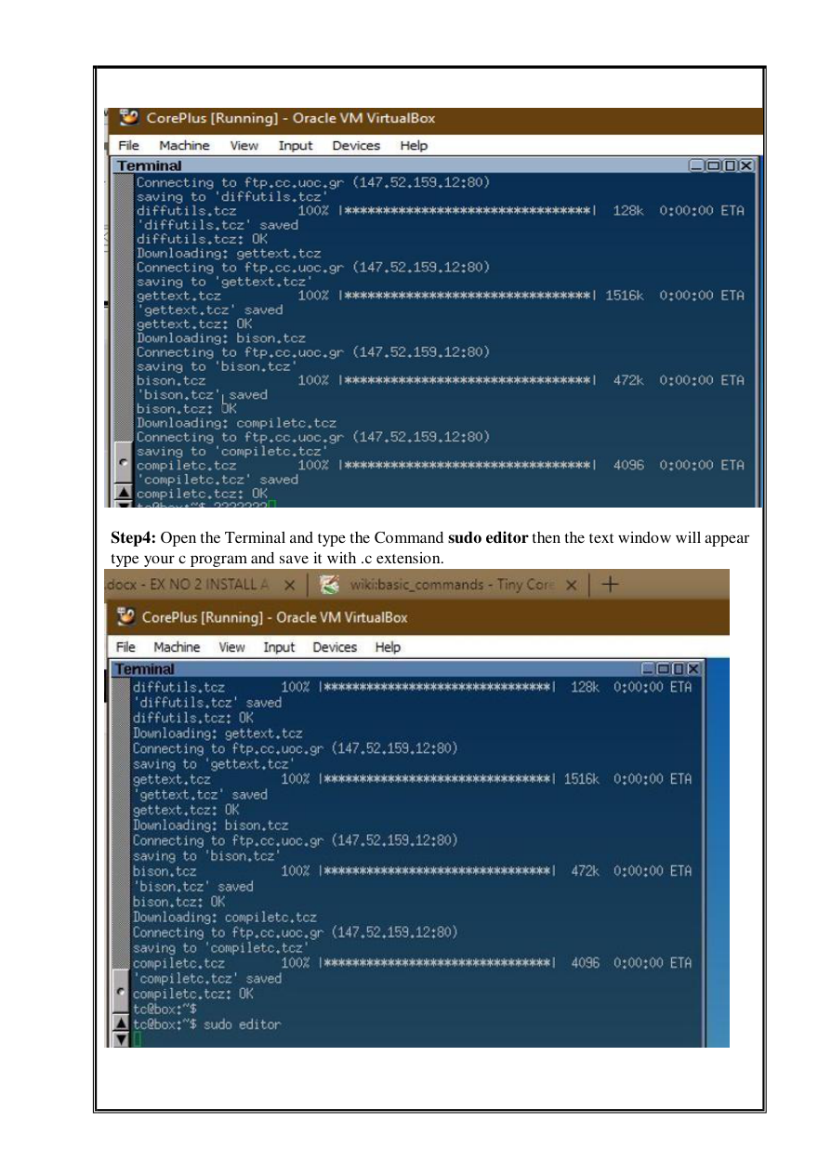
INSTALL THE C COMPILER
STEP-BY-STEP
1. Install the VMware player and host the Virtual Machine (CorePlus).
2. Open VMware Workstation and power on the virtual machine.
3. After the guest OS loads, open the Terminal.
4. Type the installation command:
tc@box:~$ tce-load -wi compiletc
5. Wait for the compiler package and required libraries to finish installing.
6. When installation completes, the terminal returns to the prompt.
CHECKPOINT ✓ The compiler toolchain is now available inside the guest VM.

Slide 6
CREATE, COMPILE & RUN
EXECUTION CYCLE
Write → Save → Compile → Run → Observe Output
The manual uses a simple leap-year C program to demonstrate that the compiler and executable are working correctly.
COMMAND / ACTION | PURPOSE
sudo editor | Open the text editor
Save as demo.c | Store the C source with .c extension
CTRL + Q | Exit editor and return to terminal
cc demo.c | Compile the C source
./a.out | Run the compiled program
Enter year: 1991 | Sample input shown in the manual
1991 is not a Leap Year | Sample output shown in the manual
Prompt returns | Program execution is complete
C SOURCE
↓
cc demo.c
↓
a.out
↓
./a.out
↓
OUTPUT

Slide 7

EXECUTE & VERIFY OUTPUT
RUN THE PROGRAM
1. Open the terminal after compilation.
2. Execute the generated program:
tc@box:~$ ./a.out
3. Enter the requested value when prompted.
4. Observe the program response in the terminal.
VERIFICATION
✓ The C source compiled without blocking errors.
✓ The executable launches from the terminal.
✓ The sample run displays: 1991 is not a Leap Year.

Slide 8
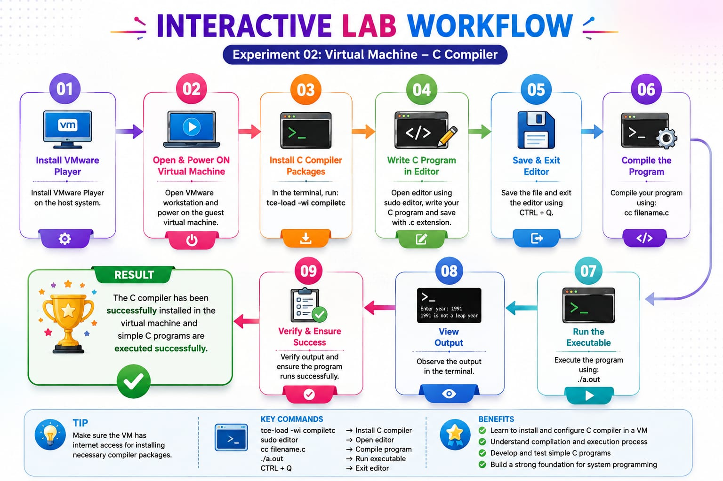
INTERACTIVE LAB WORKFLOW

Slide 9
RESULT & KEY TAKEAWAYS
RESULT
Thus the installation of a C compiler in the virtual machine created using a virtual box and execution of simple programs were completed successfully.
KEY TAKEAWAYS
• A virtual machine provides the guest environment for development.
• compiletc installs the compiler toolchain and GCC libraries.
• A C source file is saved with the .c extension.
• cc filename.c compiles the program.
• ./a.out executes the compiled program.
QUICK CHECK
What is the purpose of cc demo.c ?
Answer: It compiles the C source file into an executable program.

